Slide 1




NETFLIX
CONTENT
PREPARED BY:
NUR HUMAIRA BINTI ABDUL WAHAB (52224123318)
NUR ZAYANEE MAHFUZAH BINTI ZAYZAMRY (52224123241)
ANALYSIS

Slide 2


INTRODUCTION
Netflix is one of the most popular streaming platforms in the world, offering a wide variety of movies and TV shows.
In this project, we analyzed Netfliz’s content library to understand content trends, popular genres and content distribution across different countries.
Objectives
Explore the Netflix dataset
Identify content trends
Analyze genres, ratings and countries
Provide recommendations based on the findings

Slide 3


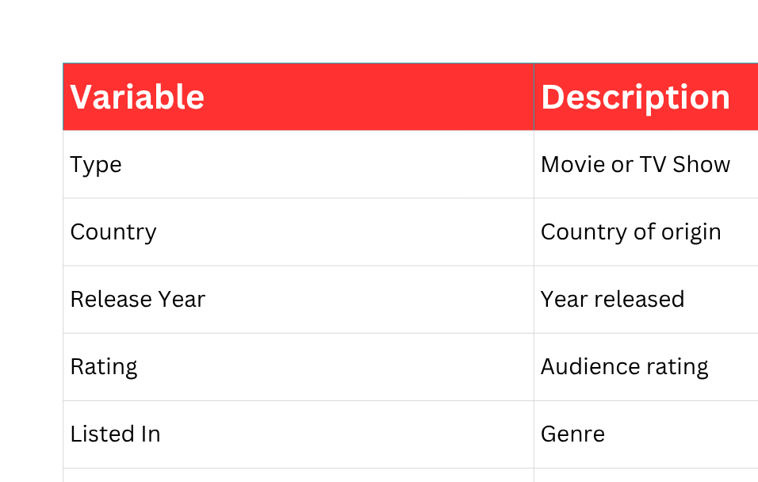
DATASET OVERVIEW
Important Variables
Dataset Information
Source: Kaggle
Number of records: 8,807
Number of variables: 12

Slide 4
DATA CLEANING
Data Cleaning Process
Before starting the analysis, we cleaned the dataset by:
Checking for missing values
Replacing missing values with “Unknown”
Checking for duplicate records
Converting data formats where necessary

Slide 5

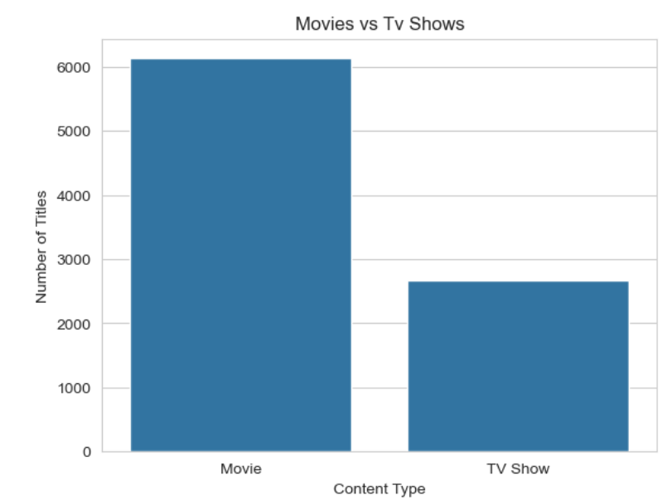
MOVIES VS TV SHOW
Movies make up a much larger portion of Netflix’s content library compared to TV Shows.

Slide 6
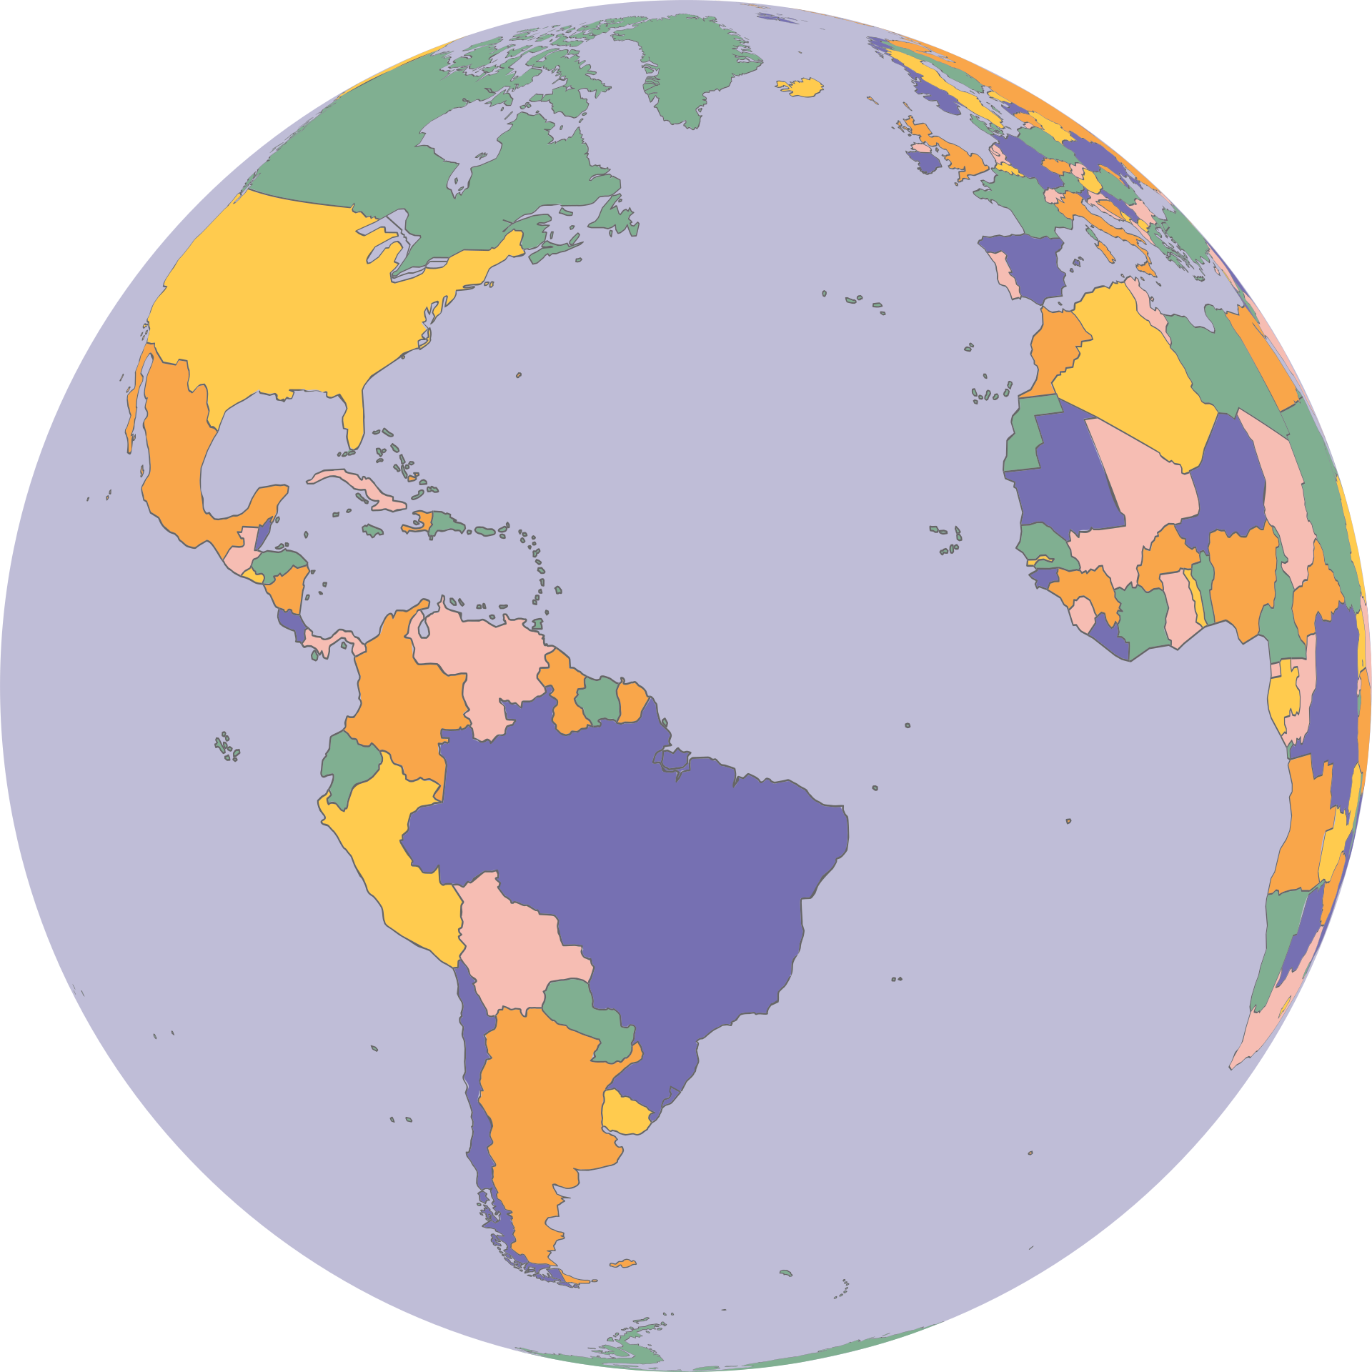
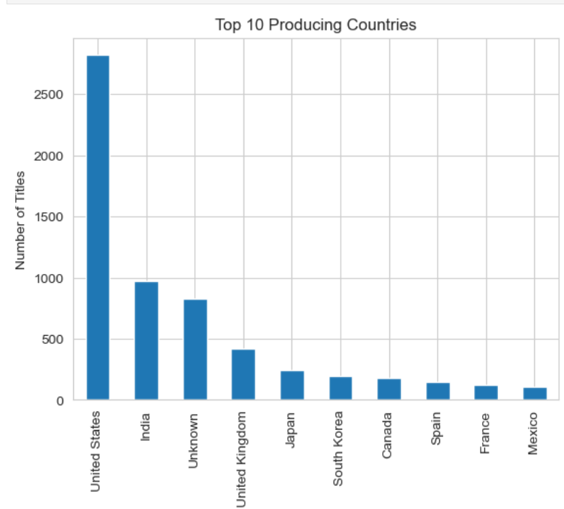
TOP PRODUCING COUNTRIES
The United States contributes the highest
number of titles on Netflix.

Slide 7
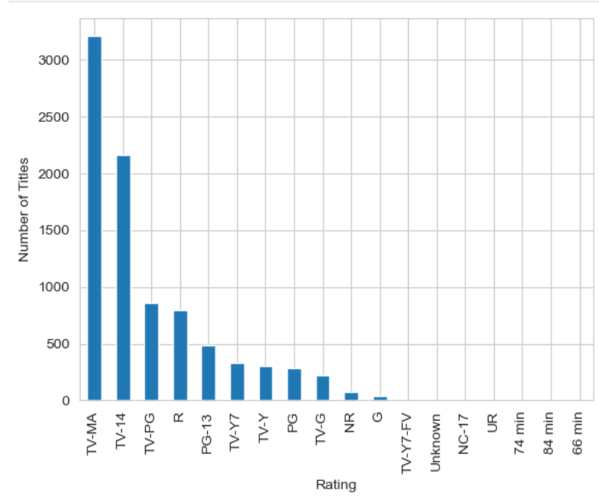

CONTENT RATINGS
TV-MA and TV-14 are the most
common ratings.

Slide 8

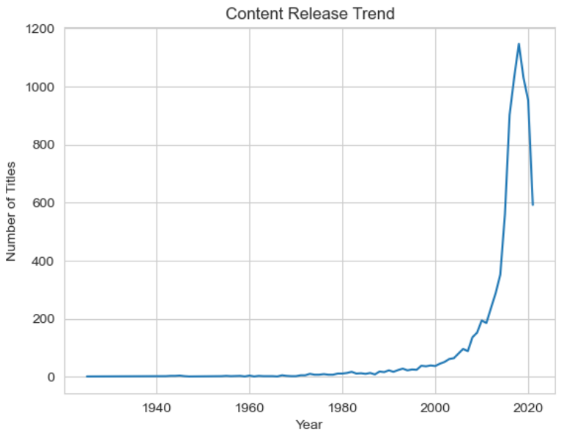
RELEASE YEAR TREND
The number of titles increased rapidly after 2010.

Slide 9

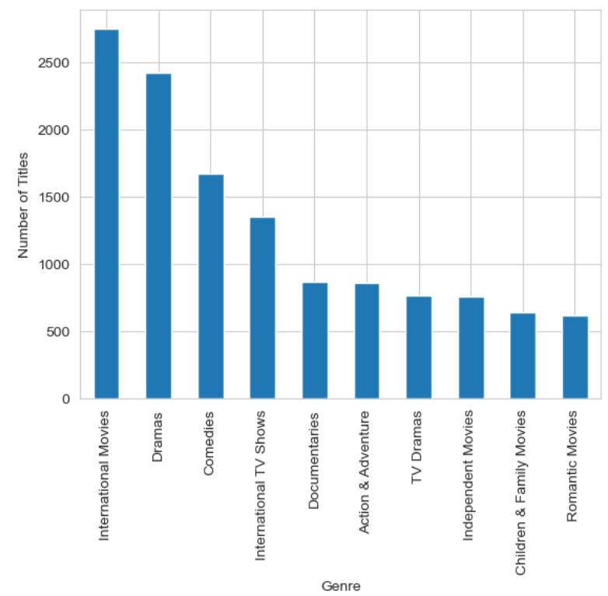

GENRE ANALYSIS
Drama and International Movies are the most common genres.

Slide 10


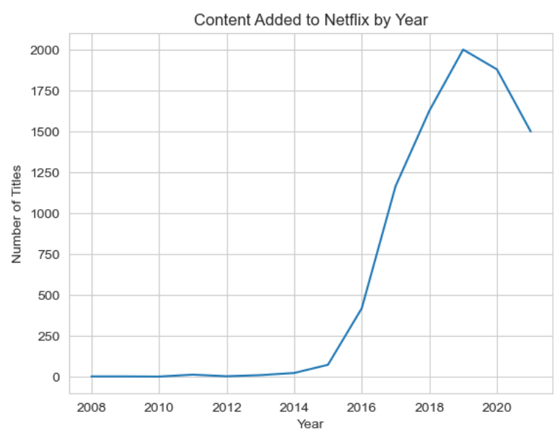
CONTENT ADDED BY YEAR
Netflix added a large amount of content between 2016 and 2020.

Slide 11
RECOMMENDATIONS
Increase investment in TV series to improve user engangement and retention.
Expand content production in international markets to reduce reliance on the United States.
Improve data quality controls to ensure more accurate and reliable information.
Ensure complete content metadata, especially country information for better analysis.
Focus on producing high-quality original content for mature and teenage audiences.

Slide 12


CONCLUSION
Movies dominate Netflix’s content library.
The United States is the largest content contributor.
Netflix mainly targets mature and teenage audiences,
Content growth increased rapidly during the 2010s before slowing in recent years.
International content plays an important role in Netflix’s catalog.
Overall, the analysis shows down that Netflix has built a strong and diverse content library but there are opportunities to improve content balance, expand international production and strengthen data quality for future growth.

Slide 13
THANK YOU

